Slide 1
NICE Bus
Bus Transit Committee Meeting Sept. 2026

Slide 2

Scorecard
Service Updates
Project Review
Board Questions
Acceptance of Q2 Scorecard
Agenda

Slide 3
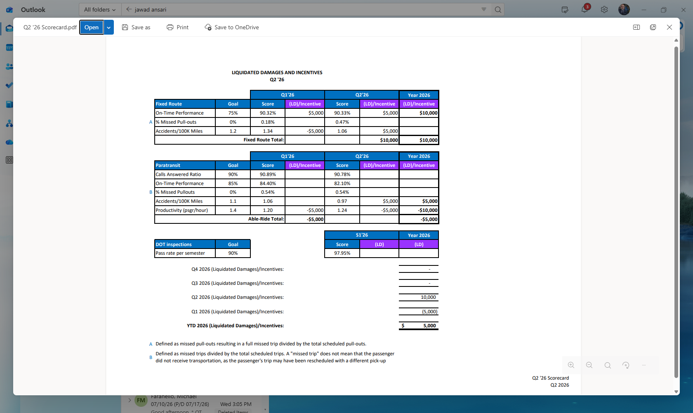
Scorecard: Q2 2026

Slide 4
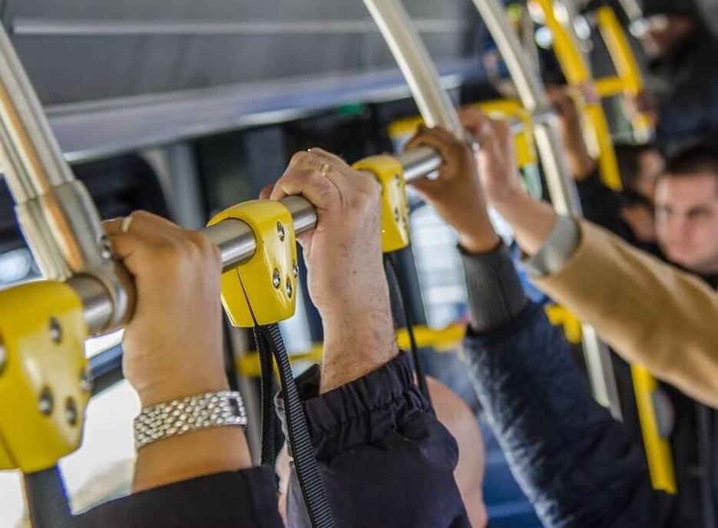
Service Updates:
Fall 2026 Service Adjustments
n16/16C Hempstead TPK / Franklin St.
All day 20min service returns for the school year to better serve Nassau Community College
n35 Grand Ave / Clinton Rd
Peak hour stop added in front of Westbury Memorial Public Library
n43 Babylon TPK / Uniondale Ave
Extended to Commercial Ave in front of the NICE Depot to reduce overcrowding at Roosevelt Field
n43X Uniondale Ave Express
Stops added closer to Nassau Community College
MINI Mile Pilot East Meadow / Bellmore
New hybrid on-demand / flex route shuttle service starts between East Meadow & Bellmore

Slide 5
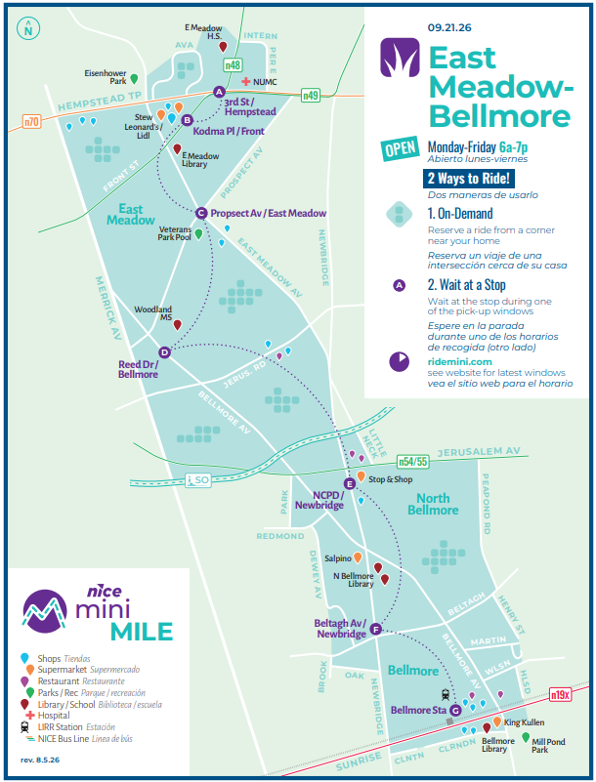

September 21st: Mini MILE will service the East Meadow-Bellmore area, offering a fixed route service from Hempstead Tpk down to the Bellmore LIRR station, with On-Demand pick up/drop off options in the Mini Mile service zone.
Service will be available Monday-Friday from 6:00 am -7:00 pm
$3.00 per trip, no surge pricing
Book your on-demand trip via our NICE Mini app or phone
Or wait at one of our Mini MILE bus stops and we will swing by to get you during the pick-up window
Credit, OMNY, coins or GoMobile app
ADA ACCESSIBLE
RIDE FREE THRU OCTOBER 31ST
Get more info at www.ridemini.com

Slide 6
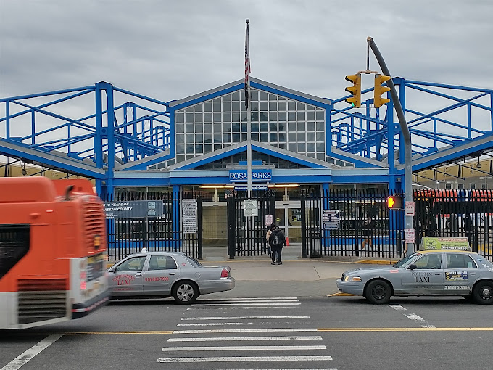
Project Updates: Capital Projects
CNG Fueling Canopy - In Process
Oak & Commercial Covered Parking – In Process
Methane Detection System – In Process
RVC Rehabilitation/Renovation – A&E In Process
New Fare Boxes – In Process
5 CNG Transit Buses – Delivered
6 Support / Supervisor Vehicles – Delivered
14 Shuttles - Delivery Q2 07
INSERT UPDATED PICTURES

Slide 7
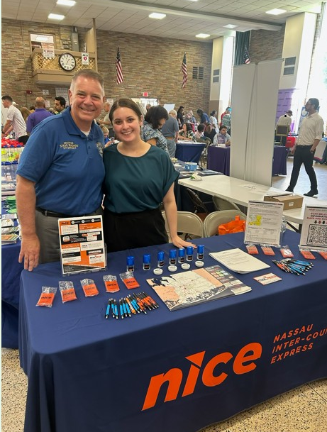
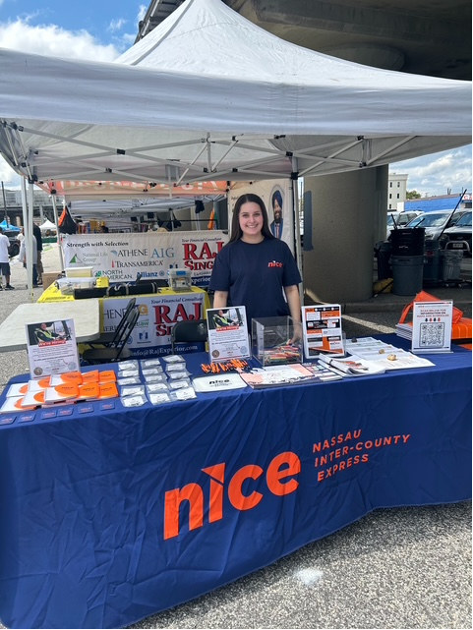
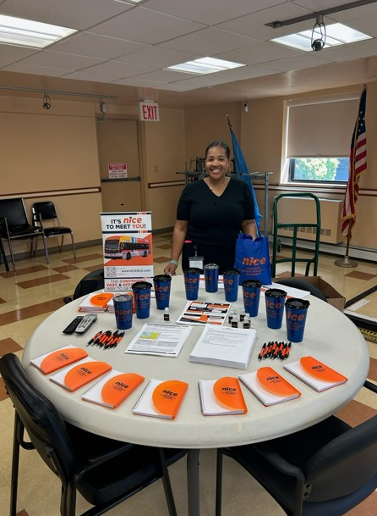
Community Engagement:
As of September, the team will have participated in 17 community outreach events ranging from educational and feedback collecting forums:
Hempstead Public Housing Authority,
Town of North Hempstead
National Night Out Events
JCC Community Resources Fair
India Day Parade

Slide 8
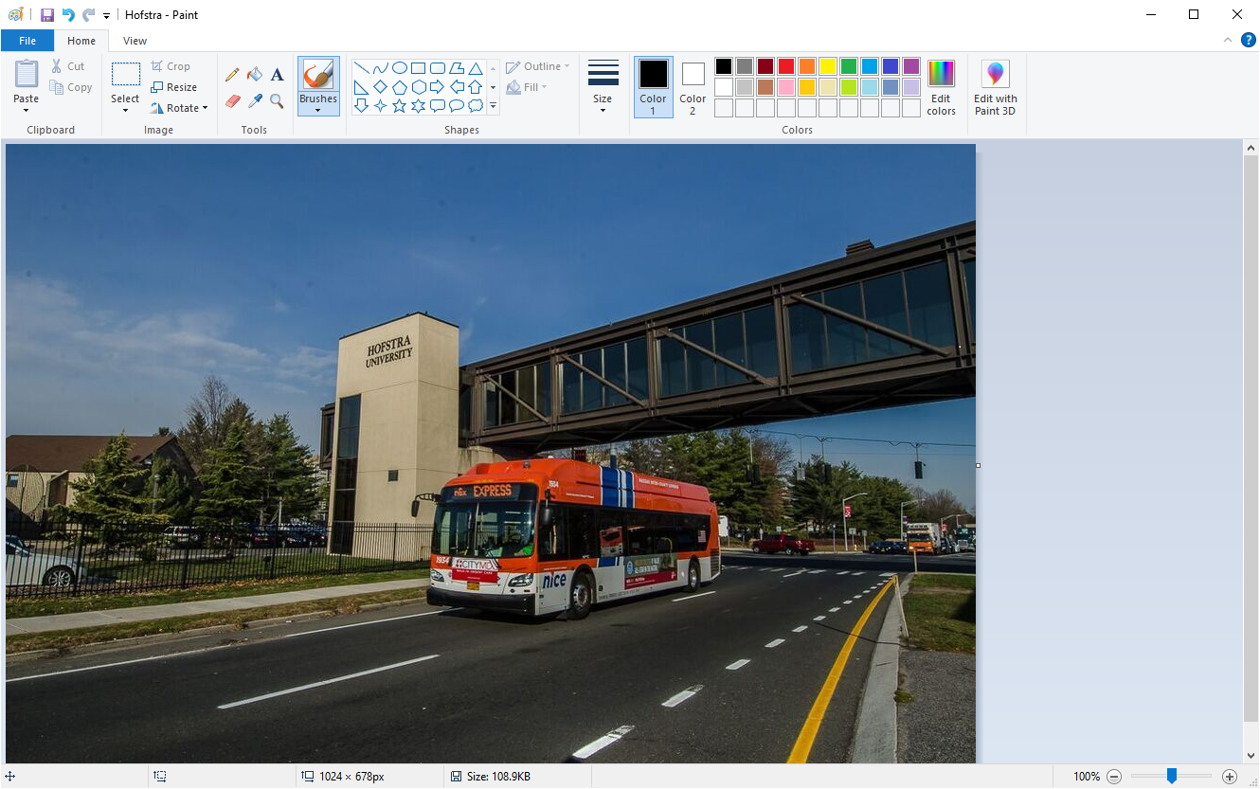
Questions / Request for Approvals 2026
Board Questions
Request: Confirmation of receipt of Q2 2026 Score Card

Slide 9
Thank You

