Slide 1
NICE Bus
Bus Transit Committee Meeting Sept. 2024

Slide 2

Agenda
Rosa Parks HTC
Scorecard
Service Updates

Slide 3
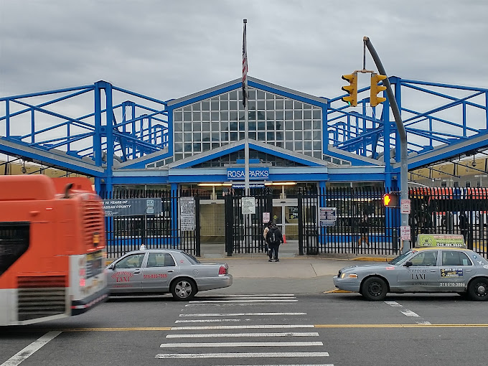
Project Updates: Rosa Parks Hempstead Transit Center
Phase 1: Complete (Jackson)
Open to the public 9/23
New floor
New wall surfaces
ADA doors
Air curtains
MetroCard machines re-installed
Phase 2: In Progress (Columbia)
Closed store front & restrooms
Temporary drivers trailer deployed
      Public porta–restrooms deployed
      Additional security & safety deployed
INSERT UPDATED PICTURES

Slide 4
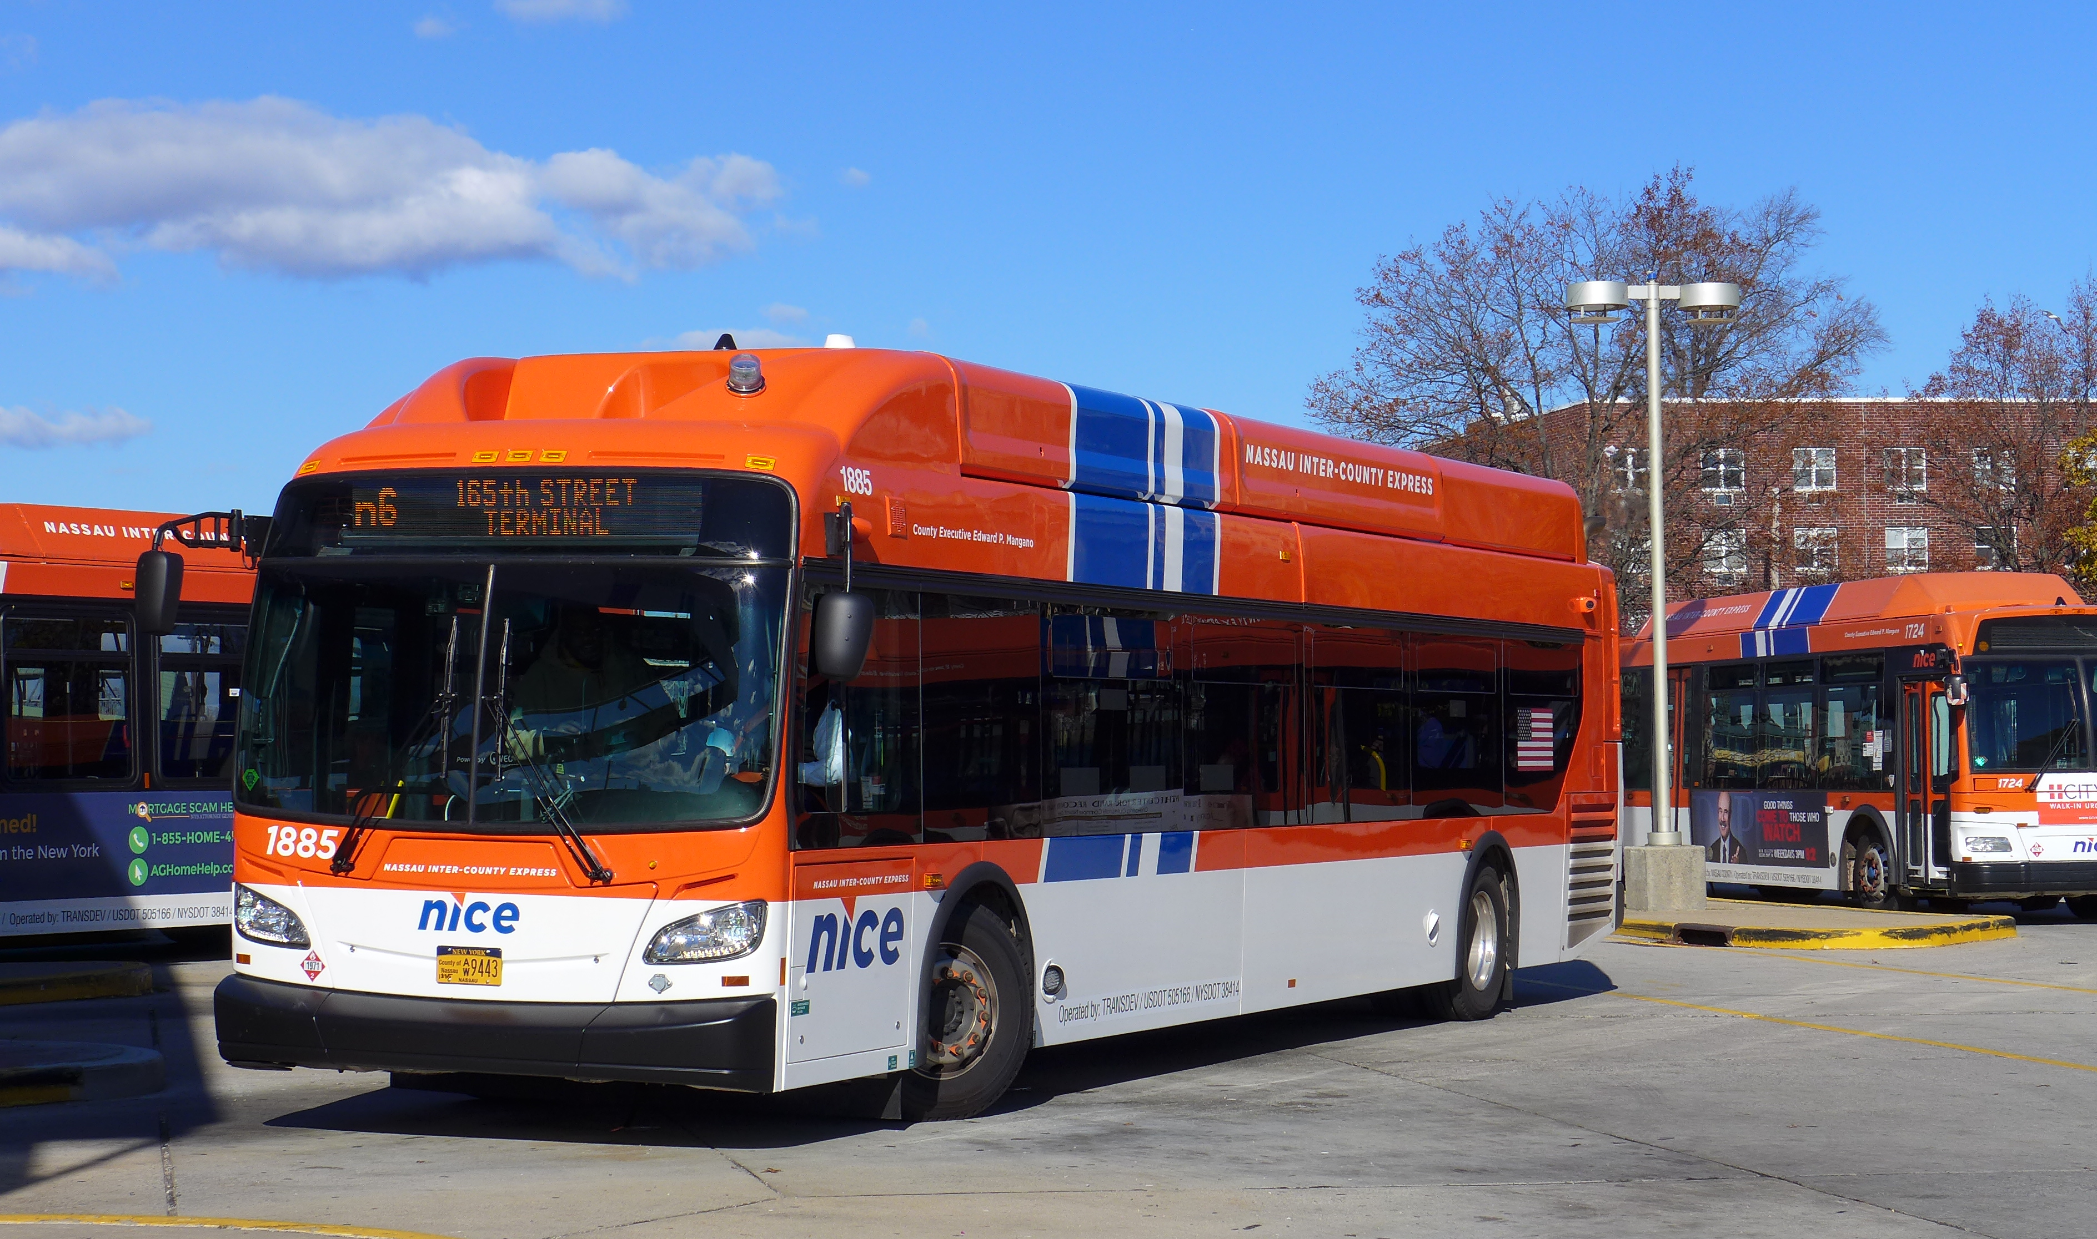
Service Updates: New Vehicles
Spring 2025
41 Gillig
compressed natural gas 40 foot buses
&
15 para transit vehicles

Slide 5
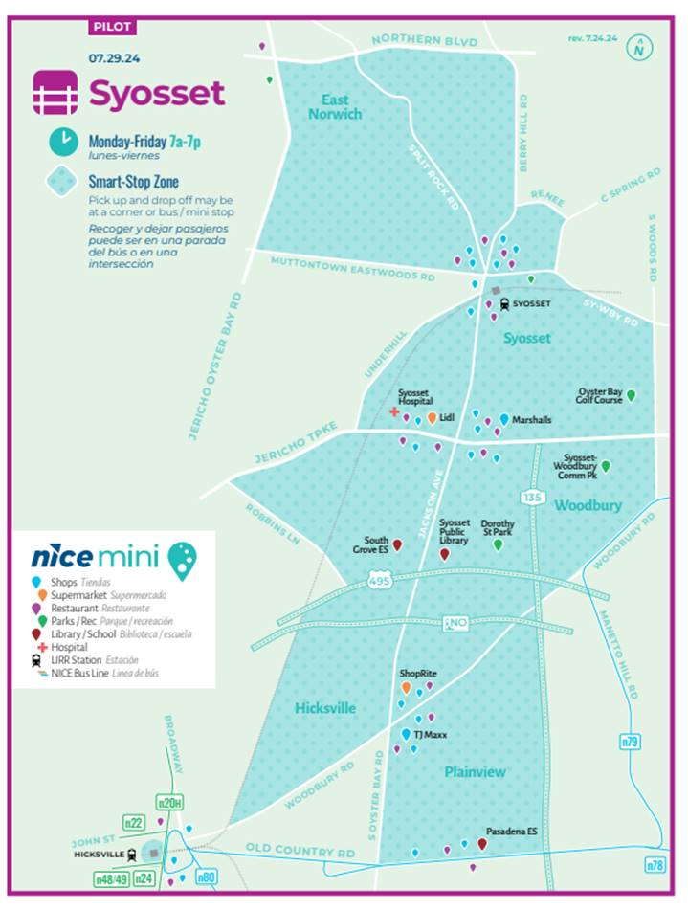

Our new NICE Mini service starts Monday, July 29th!
Get ready Syosset, a new way to travel starts Monday: NICE Mini, our On Demand service will serve the greater Syosset area, northern Plainview, parts of Woodbury, Muttontown and East Norwich.
An exciting addition to our Mini Syosset service is Able Ride+ Able Ride service in the Syosset Mini zone for all certified Able Ride Clients. Trips can be booked by calling our Reservations Team at 516-228-4173 at least 24 hours before ahead. Get more details on Able Ride + at https://www.ridemini.com/arp
Pay for Mini in our Mini app, MetroCard, coins or the GoMobile app.
For all of the details of how to ride, and our new Syosset Mini zone visit www.ridemini.com

Slide 6
Service Updates:
Fall 2024 Service Adjustments
N1 Jamaica/Elmont - Hewlett Sat / Sun service extended to UBS-Elmont LIRR Station
N16 Garden City - RVC Streamlined alignments for local and express through NCC campus
New express service in both directions
N19 Freeport - Massapequa Service east of Hicksville Rd discontinued; replaced by n80
Non-peak directional service reduced; New pilot express service via Sunrise Hwy
N22 Jamaica - Mineola/Hicksville Express trips now also serve Westbury Galleria shopping complex
N23 Mineola - Manorhaven Additional Sat / Sun frequency added
N79 Hicksville - South Huntington New weekday pilot express service via Woodbury Rd
N80 Hicksville - Massapequa Service to Sunrise Mall discontinued; ends at Sunrise Hwy & Unqua Rd;
Service east of Hicksville Rd converted to counter-clockwise loop

Slide 7

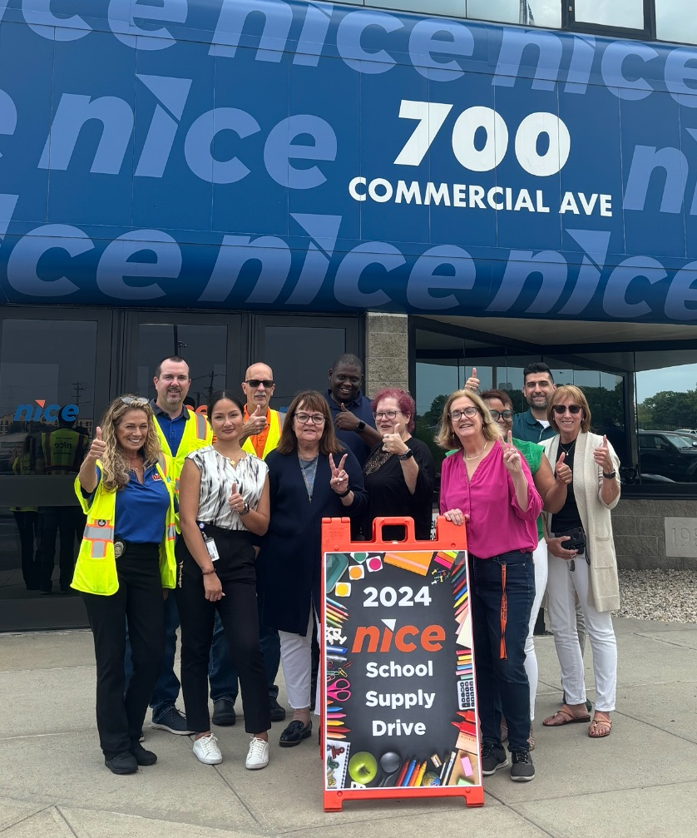
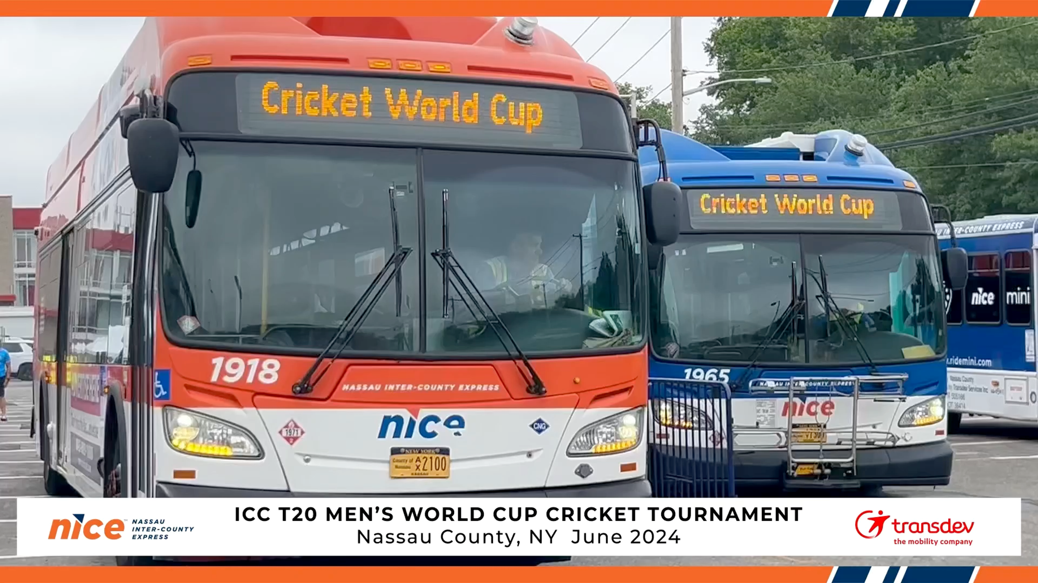
Community Engagement:
NICE Bus Employees donated over 2,500 items: backpacks, lunch bags, huge boxes of crayons, note books, pencil boxes etc.
10 days --- transported approx. 24,000

Slide 8
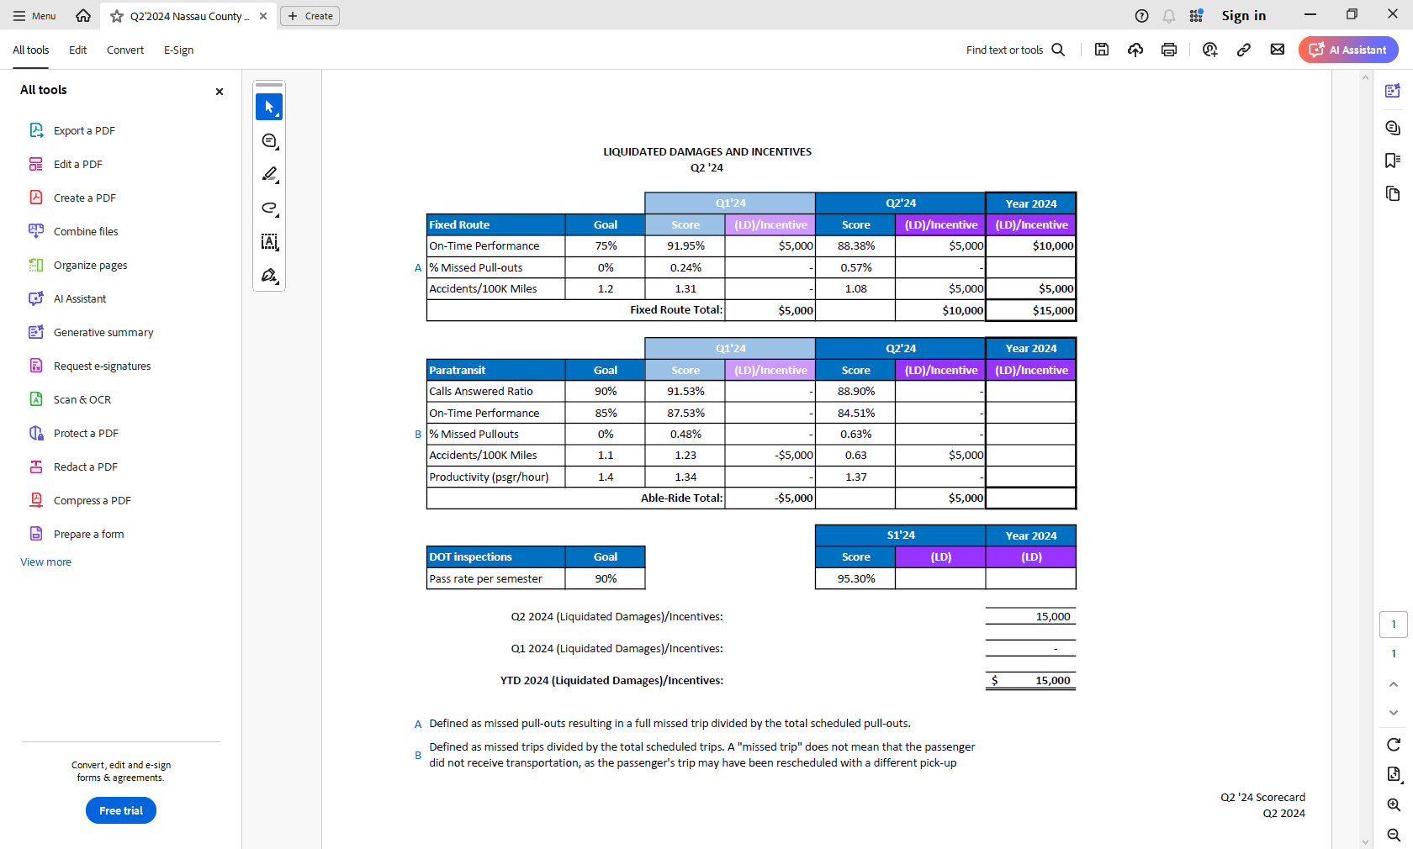
Scorecard: Q2 2024

Slide 9
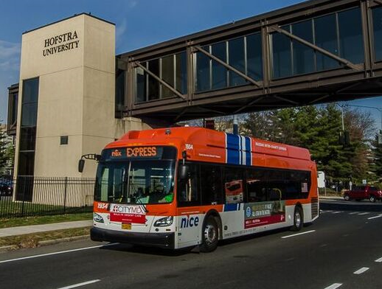
A Look Ahead:
2025 January - completion of Rosa Parks upgrades
2025 January - FTA Title VI program survey & plan
2025 Spring – new para transit & fixed route vehicles
2025 April - budget and capital plan review
2025 Summer - Oak Street charging station completed
2025 Continued work toward OMNY implementation

Slide 10
Thank You

